Slide 1
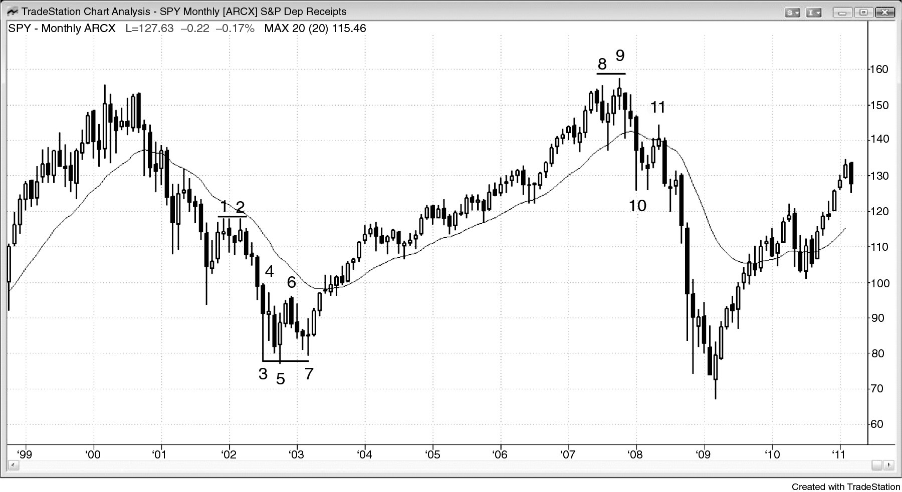
FIGURE 8.1 Double Bottom Pullback in the Monthly SPY

Slide 2
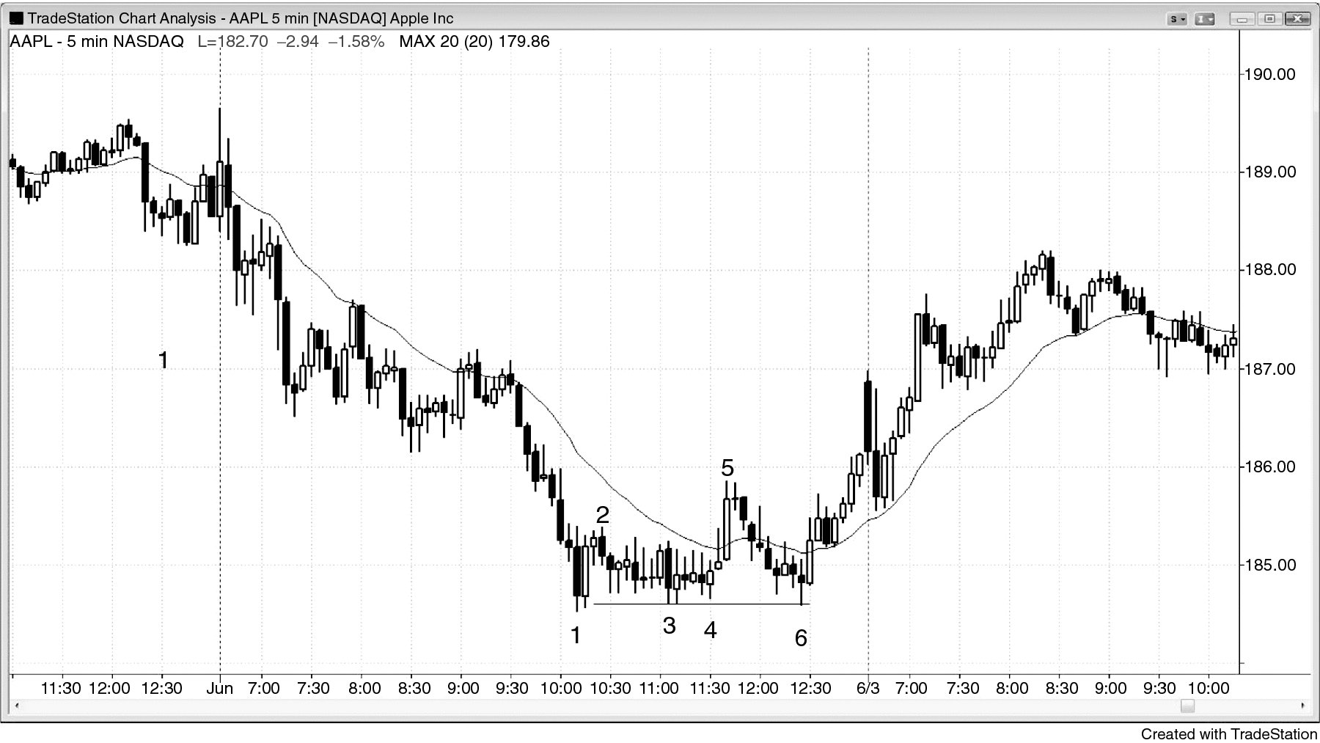
FIGURE 8.2 Bear Flag as a Double Bottom Pullback

Slide 3
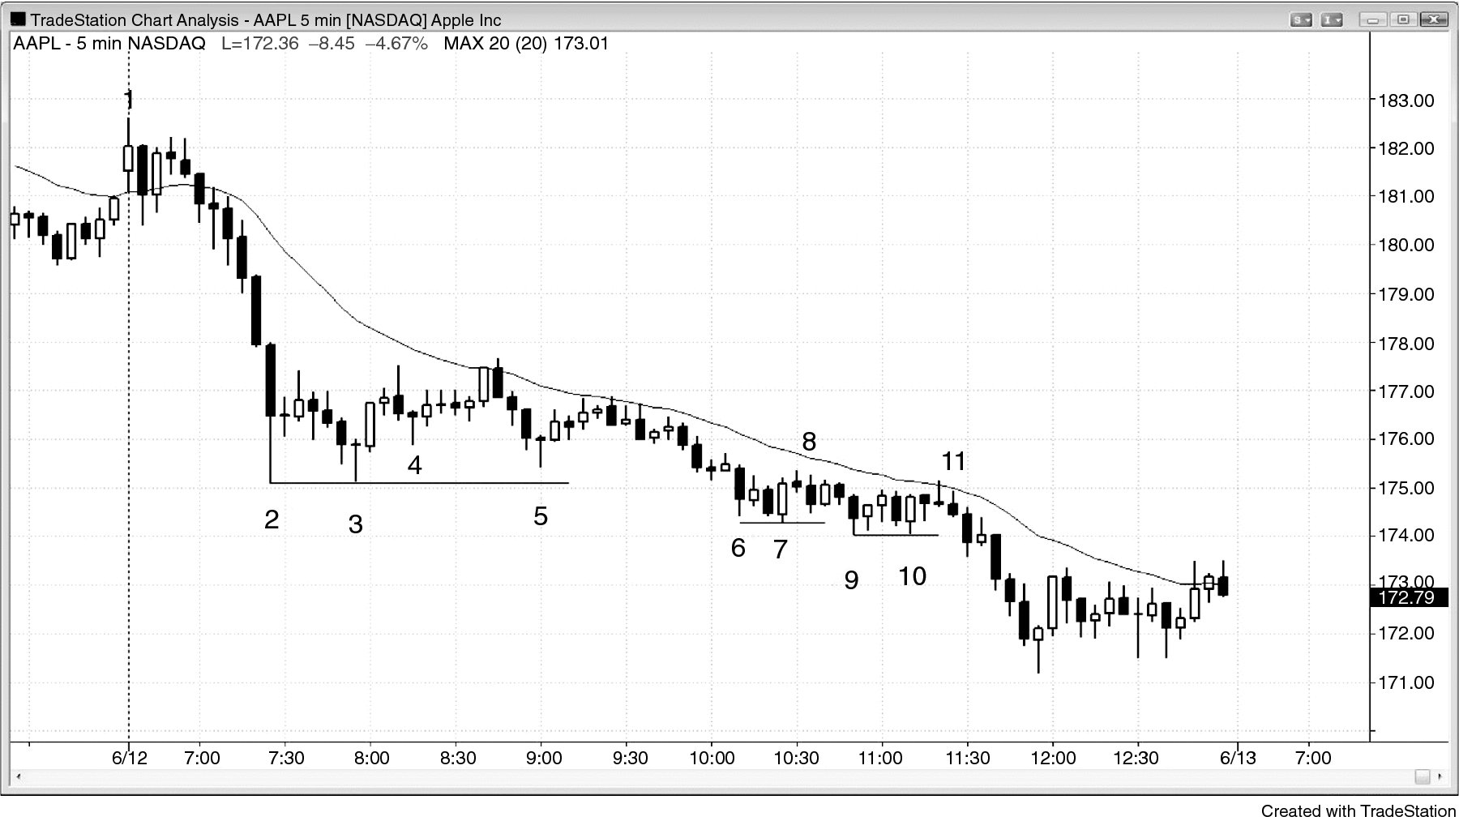
FIGURE 8.3 Weak Double Bottom Pullback

Slide 4
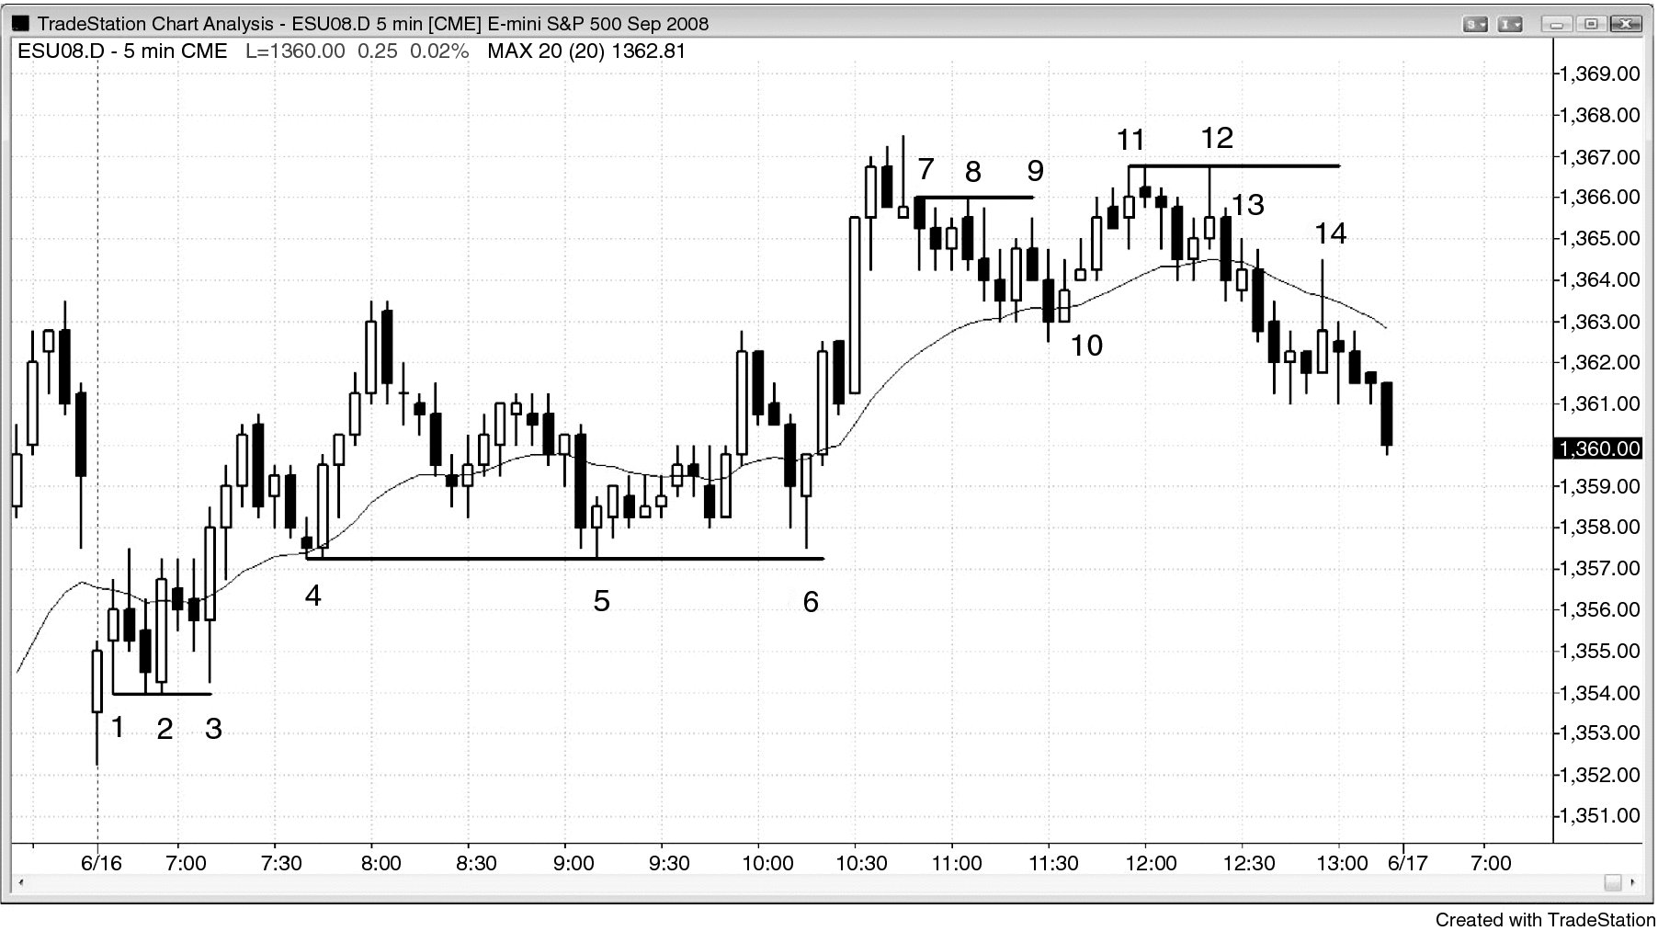
FIGURE 8.4 Double Bottom and Top Pullbacks

